Slide 1
Using Transformers to Check a Document for Completeness and Consistency
Michael Wacey

Slide 2
Glossary of Terms
Term | Definition
Coherence | Coherence in documents refers to the logical and smooth flow of ideas or information from one sentence to the next and throughout the entire piece. It's about how well the different parts of the document connect and make sense together.
Completeness | Completeness in documents refers to the thoroughness and comprehensiveness of the information presented. It means that the document contains all the necessary details to effectively convey its message or fulfill its purpose.
Consistency | Consistency of content in documents refers to the coherence and uniformity of the information presented. It ensures that the ideas and arguments flow logically, and that there are no contradictions or inconsistencies in the facts or claims.
Dynamic GNN | A dynamic GNN (Graph Neural Network) is a type of GNN specifically designed to handle graphs that evolve over time. In traditional GNNs, the graph structure remains fixed throughout the learning process. However, in many real-world applications, the relationships between nodes in a graph can change dynamically. Dynamic GNNs are equipped to handle such scenarios.
Transformer | A transformer is a neural network architecture that uses an attention mechanism to process input data in parallel, making it highly effective for tasks like machine translation and text summarization.

Slide 3
Acronyms
Acronym | Definition
AI | Artificial Intelligence
GAT | Graph Attention Networks
GCNN | Graph Convolutional Neural Network
GNN | Graph Neural Network
ML | Machine Learning
NER | Named Entity Recognition

Slide 4
Scope of Work (SOW)
There are documents, such as municipal laws, that represent the work of many people over time and end up being inconsistent and incomplete. This work focuses on checking a document for consistency and completeness. The deliverable is a transformer-based tool that reviews a document in DOCX format and regenerates the input in DOCX format with inconsistences and incompleteness annotated. Training will be based on municipal laws of Pennsylvania townships. It will have the original text, but some sections swapped between municipalities. A hold-out set of municipal laws will be used for testing.

Slide 5
Problem Statement
(A) Deliverable | (B) Format | (C) WC
Issue | Considerable effort is put into make sure that laws of Pennsylvania Townships are consistent and complete, but they always have inconsistencies and are incomplete (D. Curley, Easttown Supervisor, personal communication, September 16, 2024; A. Rau, Esq., Easttown Solicitor, personal communication, September 20, 2024; J. Sanders, personal communication, October 25, 2024).
Reference |  | NA
”so what” | Due to an inconsistency in Easttown’s laws a resident found a way to not pay a required $20,000 fee which could have cost Easttown several hundred thousand in fees a year (M. Wacey, Easttown Supervisor, personal communication, September 23, 2024). | 14
Reference |  | NA
Problem statement | Considerable effort is put into make sure that laws of Pennsylvania Townships are consistent and complete, but they always have inconsistencies and are incomplete (D. Curley, Easttown Supervisor, personal communication, September 16, 2024; A. Rau, Esq., Easttown Solicitor, personal communication, September 20, 2024; J. Sanders, personal communication, October 25, 2024), due to an inconsistency in Easttown’s laws a resident found a way to not pay a required $20,000 fee which could have cost Easttown several hundred thousand in fees a year (M. Wacey, Easttown Supervisor, personal communication, September 23, 2024).
Industry | Law | NA
PS elaboration 1 | Documents that are authored by multiple people over time inevitably develop inconsistencies and are incomplete, even with multiple reviews these often are never identified and resolved. | 26
PS elaboration 2 | If one law says that a fee is needed to cover costs, but another law says that fees cannot be collected, the township will have to use taxpayer money. | 29

Slide 6
Problem Statement (OLD)
(A) Deliverable | (B) Format | (C) WC
Issue | Checking that documents are complete and consistent is difficult (NASA, 1999). | 9
Reference | NASA (1999). Mars Climate Orbiter Mishap Investigation Board Phase I Report. Retrieved from https://llis.nasa.gov/llis_lib/pdf/1009464main1_0641-mr.pdf | NA
”so what” | As an example, document inconsistencies cost NASA $198 Million on the Mars Climate Orbiter (NASA, 1999). | 14
Reference | NASA (1999). Mars Climate Orbiter Mishap Investigation Board Phase I Report. Retrieved from https://llis.nasa.gov/llis_lib/pdf/1009464main1_0641-mr.pdf | NA
Problem statement | Checking that documents are complete and consistent is difficult (NASA, 1999), as an example document inconsistencies cost NASA $198 Million on the Mars Climate Orbiter (NASA, 1999). | 23
Industry | Engineering and Law | NA
PS elaboration 1 | Documents that are authored by multiple people over time inevitably develop inconsistencies and are incomplete, even with multiple reviews these often are never identified and resolved. | 26
PS elaboration 2 | If one law says that a fee is needed to cover costs, but another law says that fees cannot be collected, the township will have to use taxpayer money. | 29

Slide 7
Thesis Statement
(A) Deliverable |  | WC
Thesis Statement | A transformer-based tool to check a document for consistency and completeness will reduce the negative implications of these mistakes, saving considerable money. | 28
Research Product | Transformer-based tool | NA
Format | Python Program | NA
Deliverable Usage | Lawyers who draft new regulations will use the tool to check if the new regulation adds any inconsistencies. | 18
Tie back to PS | Inconsistent and incomplete laws are found sooner and resolved thereby eradicating their cost to the municipality and taxpayers. | 18
New Contributions | Work has focused on financial documents and business requirements to date. It has not leveraged the power of transformers. | 19
Scope | I am using municipal laws due to the free availability of laws. The tool should be able to work on any large documents. | 23
Main methodology | Transformers | NA
Inputs | A subset of the laws of the 1,456 Pennsylvania Townships of the Second Class, Easttown Township (DOCX), Willistown Township (DOCX), etc. | NA
Outputs | Laws annotated with anything that is inconsistent or incomplete in DOCX format. | NA

Slide 8
Research Questions
(A) Deliverable | (B) Format | (C) WC
Research Question 1 | Can using a GNN to label entities, such as a person or a company, be used to accurately determine consistency and completeness of municipal laws? | 15
Research Question 2 | Can a transformer-based model accurately determine consistency of municipal laws? | 16
Research Question 3 | Can a transformer-based model accurately determine incompleteness of municipal laws? | 25

Slide 9
Research Questions (OLD)
(A) Deliverable | (B) Format | (C) WC
Research Question 1 | Can a neural network-based model accurately determine consistency and completeness of a law document? | 15
Research Question 2 | Which of GNN, CNN, or transformers most accurately determines consistency and completeness of a law document? | 16
Research Question 3 | Can using a GNN to label entities, such as a person or a company, be used to accurately determine consistency and completeness of law document? | 25

Slide 10
Research Hypotheses
(A) Deliverable | (B) Format | (C) WC
Hypothesis 1 | A GNN can label entities that are used to determine the consistency and completeness of municipal laws. | 19
Independent Variables | Words, sentences, paragraphs in municipal laws that have been checked for inconsistencies and incompleteness by lawyers and compilers. | NA
Dependent Variable | Identifies inconsistencies or incompleteness | NA
Testable | Review generated GNN graphs to identify differences between graphs of consistent/inconsistent and complete/incomplete entities. | 16
Hypothesis 2 | A transformer-based model can accurately determine consistency of a municipal laws. | 15
Independent Variables | Words, sentences, paragraphs in municipal laws that have been checked for inconsistencies by lawyers and compilers. | NA
Dependent Variable | Identifies inconsistencies | NA
Testable | Switch paragraphs in documents and see if the model detects the inconsistency. | 22
Hypothesis 3 | A transformer-based model can accurately determine incompleteness of municipal laws. | 15
Independent Variables | Words, sentences, paragraphs in municipal laws that have been checked for incompleteness by lawyers and compilers. | NA
Dependent Variable | Identifies incompleteness | NA
Testable | Remove paragraphs and see if the model detects the incompleteness. | 22

Slide 11
Research Hypotheses (OLD)
(A) Deliverable | (B) Format | (C) WC
Hypothesis 1 | A neural network-based model can accurately determine consistency and completeness of a law document. | 15
Independent Variables | Words, sentences, paragraphs in a law document that has been checked for inconsistencies and incompleteness by lawyers and compilers. | NA
Dependent Variable | Identifies inconsistencies or incompleteness | NA
Testable | Switch paragraphs in documents and see if the model detects the inconsistency. Remove paragraphs and see if the model detects the incompleteness. | 22
Hypothesis 2 | Transformers perform more accurately than a GNN or CNN, to determine the consistency and completeness of a law document. | 19
Independent Variables | Words, sentences, paragraphs in a law document that has been checked for inconsistencies and incompleteness by lawyers and compilers. | NA
Dependent Variable | Identifies inconsistencies or incompleteness | NA
Testable | Implement multiple models based on Transformers, GNNs, and CNNs and compare their accuracy. | 15
Hypothesis 3 | Using a GNN to label entities can be used to determine the consistency and completeness of a law document. | 19
Independent Variables | Words, sentences, paragraphs in a law document that has been checked for inconsistencies and incompleteness by lawyers and compilers. | NA
Dependent Variable | Identifies inconsistencies or incompleteness | NA
Testable | Review generated GNN graphs to identify differences between graphs of consistent/inconsistent and complete/incomplete entities. | 16

Slide 12
Annotated Bibliography (1 of 5)
(A) Deliverable | (B) Format | (C) WC
Reference | Laban, P., Dai, L., Bandarkar, L., & Hearst, M. A. (2021). Can Transformer Models Measure Coherence In Text? Re-Thinking the Shuffle Test. arXiv (Cornell University), 10.48550/arxiv.2107.03448 | NA
Summary | Introduces the concept of coherence and the difficulty defining it. Summarizes the various ways to measure coherence and focuses on the shuffle test. Shows that the shuffle test can have a perfect score but still not measure coherence. | 10 13 15
Methodology | GPT-2 | NA
Evaluation | Aggregate model performance drops from 94.5% for block-size 1 to 77.9% for block-size 5. Identifies the problem that shuffle test can be perfect without measuring coherence. Identifies a solution (zero shot shuffle test) that does as well as humans, 97.5% for human's vs 94.5 for average model. | 14 12 21
Relevance | Provided me with the term coherence for consistency. Provided me with many references on coherence and how to test it. Confirmed that this is a problem being researched. | 8 12 8

Slide 13
Annotated Bibliography (2 of 5)
(A) Deliverable | (B) Format | (C) WC
Reference | Gemelli, A., Biswas, S., Civitelli, E., Lladós, J., & Marinai, S. (2022). Doc2Graph: a Task Agnostic Document Understanding Framework based on Graph Neural Networks. (). Ithaca: Cornell University Library, arXiv.org. 10.48550/arxiv.2208.11168 Retrieved from Publicly Available Content Database https://www.proquest.com/docview/2706457673/abstract/ | NA
Summary | Historically documents have been understood as they relate to specific tasks. This article takes a structural approach to understanding documents using GNNs. The approach is applied to form and invoice understanding. | 11 11 9
Methodology | Graph Neural Networks (GNN) | NA
Evaluation | The article compares the GNN approach to existing approaches. They have a good F1 on forms (0.82 vs 0.81) and a better F1 (0.37 vs 0.31) on invoices. But they only need 6.2 x 10⁶ parameters vs 138 x 10⁶ parameters. | 9 19 13
Relevance | I had planned to use GNNs to process the documents, and this seems very related to that. It provides me with a start on how to process documents into a form that can be used for consistency and completeness checks. | 17 23

Slide 14
Annotated Bibliography (3 of 5)
(A) Deliverable | (B) Format | (C) WC
Reference | Yang, J., Yoon, S., Kim, B., & Lee, H. (2024). FIZZ: Factual Inconsistency Detection by Zoom-in Summary and Zoom-out Document. arXiv (Cornell University), 10.48550/arxiv.2404.11184 | NA
Summary | A new approach to check that the summary of a document is consistent with a document. Break the summary down into Atomic Facts. Compare Atomic Facts to the original document. | 16 7 7
Methodology | Natural Language Inference (NLI) | NA
Evaluation | They only looked at article and news domains, no results for other domains. The tool does not create the summaries. Higher interpretability by breaking it down into Atomic Facts. FIZZ performed with highest average accuracy (71.2) on two standard data sets (AggreFact-Cnn, AggreFact-XSum). | 13 7 9 14
Relevance | This will be useful to break a document down for analysis, into the Atomic Facts. The approach works well but is slow. | 15 7

Slide 15
Annotated Bibliography (4 of 5)
(A) Deliverable | (B) Format | (C) WC
Reference | Aumiller, D., Almasian, S., Lackner, S., & Gertz, M. (Jun 21, 2021). Structural text segmentation of legal documents. Paper presented at the 2–11. 10.1145/3462757.3466085 | NA
Summary | They use LLMs to process legal documents into a standard structure. Most previous work focused on sentences while this work focuses on paragraphs. The data they use is Terms of Service from over 70,000 web sites where they have extracted section headings to use as labels. | 11 12 23
Methodology | Transformers using models from Hugging Face. | NA
Evaluation | They show improvement in errors with their method over prior methods Ensemble approaches performed better. For example, one prior method had an error rate (misclassification of a section) of 32.28 while the authors approach had an error rate of 12.95. | 11 4 25
Relevance | This paper makes it clear that Transformers can be used to understand legal documents and their structure. There are many references in this paper that will help me. My expectation had been that paragraphs would be the right unit to work with and this confirms that. | 17 11 18

Slide 16
Annotated Bibliography (5 of 5)
(A) Deliverable | (B) Format | (C) WC
Reference | Carbonell, M., Riba, P., Villegas, M., Fornes, A., & Llados, J. (Jan 10, 2021). Named Entity Recognition and Relation Extraction with Graph Neural Networks in Semi Structured Documents. Paper presented at the 9622–9627. 10.1109/ICPR48806.2021.9412669 https://ieeexplore.ieee.org/document/9412669 | NA
Summary | The task is to take a document, group words that relate to an entity, label the entities, and identify pair wise relationships between entities. They use a GNN to learn how to do these tasks. They use the FUNSD and IEHHR datasets. | 24 11 7
Methodology | GNN, k-NN, GAT | NA
Evaluation | They compare F1 scores for labeling and linking to previous work on the FUNSD data set and show an F1 of 0.64 on labeling and 0.39 on linking which is better for linking but worse for labeling. For IEHHR they have 0.53 for labeling and 0.67 for linking but there is no prior work on this data set. | 37 21
Relevance | This will provide me with an approach to understand the main entities of the law documents. This shows how to use a GNN to process a law document. | 16 12

Slide 17
Data Sources List
ID | Name | Source | Brief Description | Format | Time Span | Num. of records | Access (Y/N)
1 | Easttown Code | eCode 360 - https://ecode360.com/EA3052 | The Laws of Easttown Township, Pennsylvania as enacted by the Board of Supervisors. | Word File | About 1940 to 10/16/2023 | 4.42 MB and 732 pages and 288,412 words | Y
2 | Tredyffrin Code | eCode 360 - https://ecode360.com/TR1485 | The Laws of Tredyffrin Township, Pennsylvania as enacted by the Board of Supervisors. | Word File | About 1940 to 6/17/2024 | 6.69 MB and 819 pages and 318,231 words | Y
3 | .. | .. | .. | .. | .. | .. | ..

Slide 18
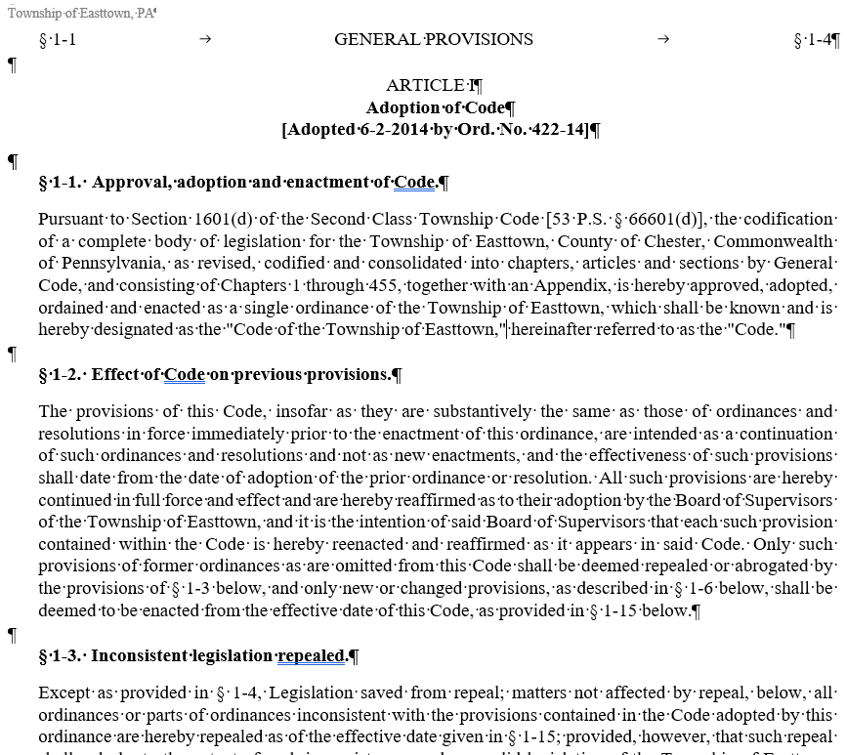
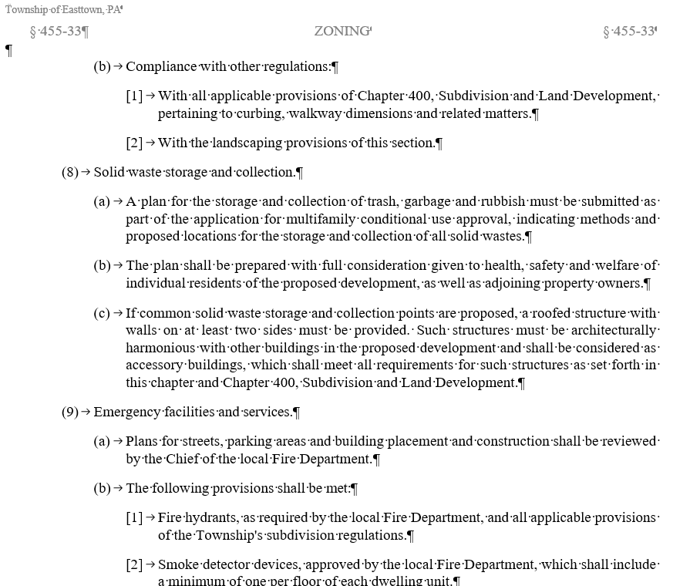
Data Source Example
ID | Name | Source | Brief Description | Format | Time Span | Num. of records | Access (Y/N)
1 | Easttown Code | eCode 360 - https://ecode360.com/EA3052 | The Laws of Easttown Township, Pennsylvania as enacted by the Board of Supervisors. | Word File | About 1940 to 10/16/2023 | 4.42 MB and 732 pages and 288,412 words | Y
Item | Description | WC
Purpose | Provides me with real world examples of large law documents that I can manipulate to create inconsistences and incompleteness. | 19
Data Treatment | For some of these documents, I will inject inconsistency and remove sections to make it incomplete. The document will be processed by a GNN to create a graph that documents the entities within the document. The graph will be processed by a Transformer to identify inconsistent or incomplete entities. | 16 19 14
Page 3 of the document. I looked for a table of contents but did not find one.
Page 531 of the document.

Slide 19
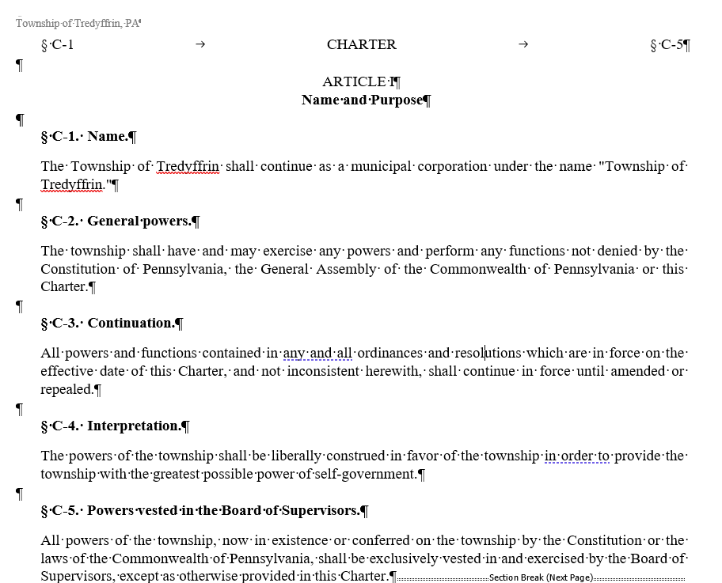
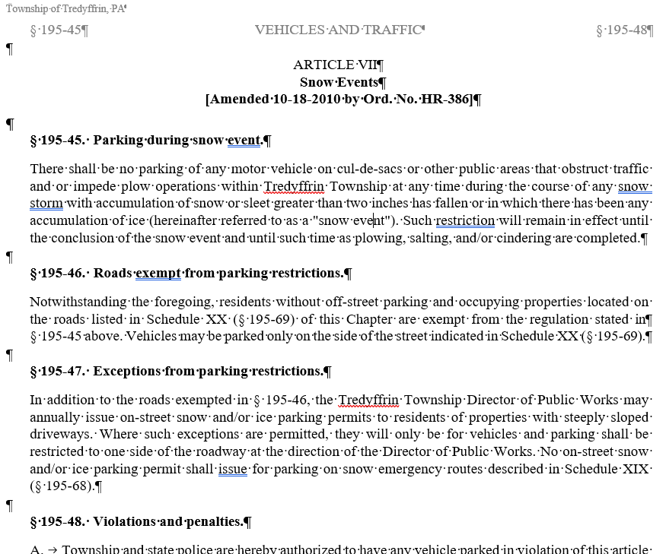
Data Source Example
ID | Name | Source | Brief Description | Format | Time Span | Num. of records | Access (Y/N)
2 | Tredyffrin Code | eCode 360 - https://ecode360.com/TR1485 | The Laws of Tredyffrin Township, Pennsylvania as enacted by the Board of Supervisors. | Word File | About 1940 to 6/17/2024 | 6.69 MB and 819 pages and 318,231 words | Y
Item | Description | WC
Purpose | Provides me with real world examples of large law documents that I can manipulate to create inconsistences and incompleteness. | 19
Data Treatment | For some of these documents, I will inject inconsistency and remove sections to make it incomplete. The document will be processed by a GNN to create a graph that documents the entities within the document. The graph will be processed by a Transformer to identify inconsistent or incomplete entities. | 16 19 14
Page 3 of the document. I looked for a table of contents but did not find one.
Page 531 of the document.

Slide 20
Appendix

Slide 21
APA Guidelines^{(*)}
Source citation consists of:
A brief parenthetical citation in the text
A full reference at the end of the paper
APA In-text Citations
An APA in-text citation includes the author’s last name and the publication year.
If you’re quoting or paraphrasing a specific passage, you also add a page number.
1 author | (Taylor, 2018, p. 23)
2 authors | (Taylor & Kotler, 2018, p. 23)
3–5 authors | First citation: (Taylor, Kotler, Johnson, & Parker, 2018, p. 23) Subsequent citations: (Taylor et al., 2018, p. 23)
6+ authors | (Taylor et al., 2018, p. 23)
APA Reference List
Smith, T. (2019). Citing sources and referencing: A quick guide. (J. M. Taylor, Ed.) (2nd ed.). Amsterdam, The Netherlands: Scribbr.
In-text citation
According to new research (Smith, 2019, pp. 11–12) …
As mentioned before (Smith, 2019, pp. 11–12) …
(See Smith, 2019)
* https://www.scribbr.com/citing-sources/apa-vs-mla/

